Slide 1
Virtual Gaming Through Human Gesture Detection Using Deep Learning
Submitted by :
Mohammed Anas Affaf (18AT1A0513)
A S Abdul Kalam (18AT1A0502)
Moulvi Kaif Ahmed (18AT1A0557)
Sheik Aslam Basha (18AT1A0522)
Project Guide :
Ms. M. Sri Lakshmi

Slide 2
Abstract
Virtual environments are designed to provide natural, efficient, powerful, and flexible human computer interaction. However, virtual worlds are not well-suited to the standard two-dimensional, keyboard-and-mouse-oriented graphical user interface. This will look at the most prevalent methods for capturing, monitoring, and recognizing many modalities at the same time in order to develop an intelligent human-computer interface for games. Given the wide range of gestures and their importance in building intuitive interfaces, the techniques under consideration concentrate on gestures, while they may be applied to other modalities as well. The methods under consideration are user-independent and do not need huge learning samples.
In this project, a model is developed that collects user gestures using a camera and uses the open-source free computer vision library OpenCV to convert real-time human motions into keyboard input for video game control.

Slide 3
CONTENTS
01
02
03
Abstract
Existing vs Proposed
System Architecture
Brief description of Project
Comparison
Program workflow
04
05
06
Expected Results
Hardware Requirements
Domain
Minimum requirements to run the script
Preview of expected result.
Technologies Used

Slide 4
Existing System
Proposed System
Kinect is a line of motion sensing input
devices produced by Microsoft and first
released in 2010. The devices generally
contain RGB cameras, and infrared projectors and detectors that map depth through either
structured light or time of flight calculations, which can in turn be used to perform
real-time gesture recognition and body
skeletal detection, among other capabilities.
With the use of the latest deep learning algorithms, we can achieve similar motion sensing
functionality with any camera and give a cost-effective way to perform real-time gesture
identification and body skeleton detection in our proposed model.

Slide 5
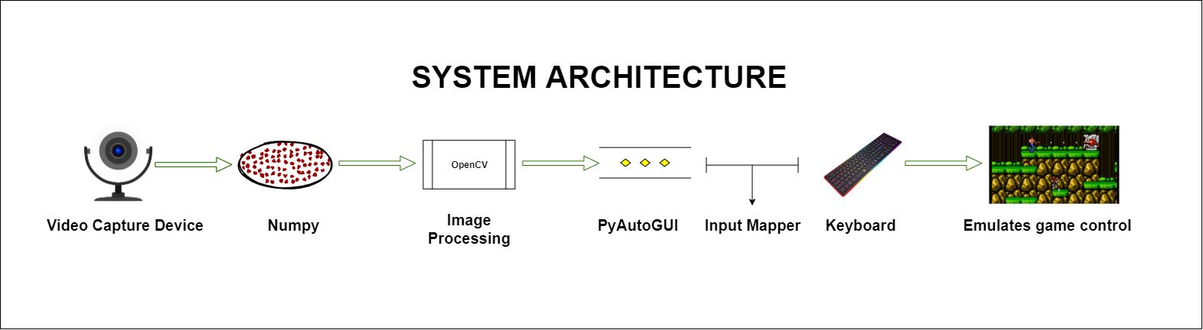
System Architecture

Slide 6
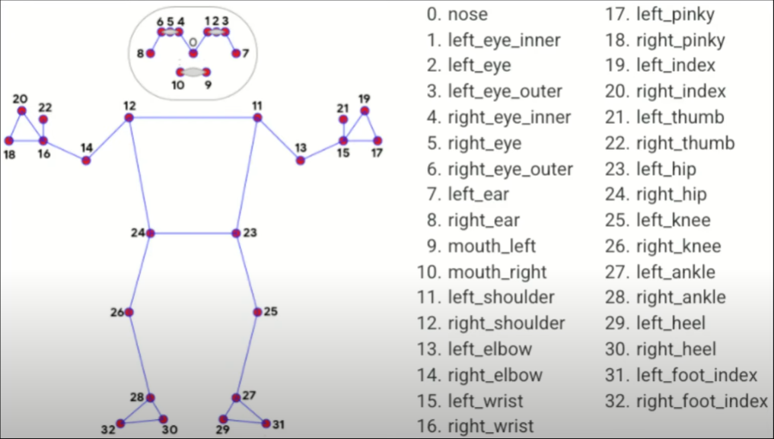
Frame Media Pipe Diagram

Slide 7
Frame Media Pipe Diagram

Slide 8
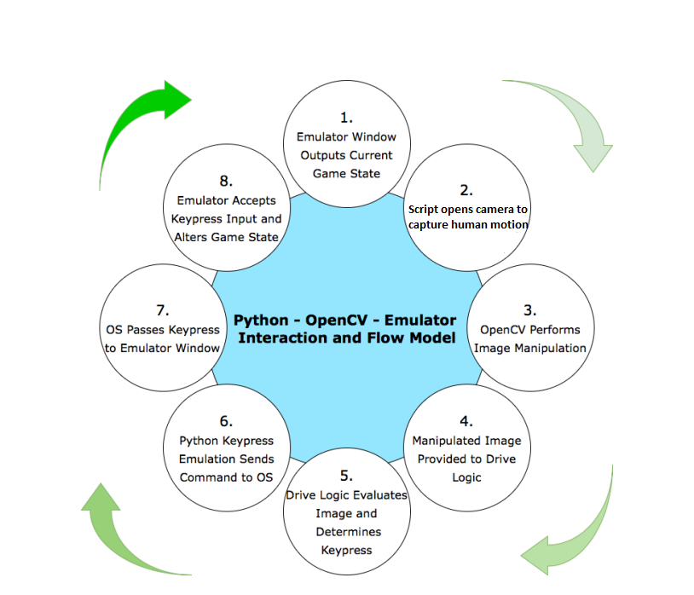
Flow Diagram of the proposed model.

Slide 9
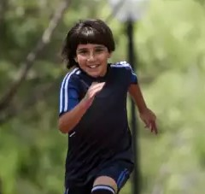
Expected Result
Gameplay
Motion Pose (is Running)

Slide 10

Expected Result
Gameplay
Motion Pose (is Jumping)

Slide 11

Expected Result
Gameplay
Motion Pose (is Shooting)

Slide 12
4 GB of Ram
i5 processor
Any GPU
Windows/Linux
Hardware
Requirements

Slide 13
OpenCV
MediaPipe
PyAutoGUI
Deep learning
Technologies Used

Slide 14
THANK YOU

